Slide 1
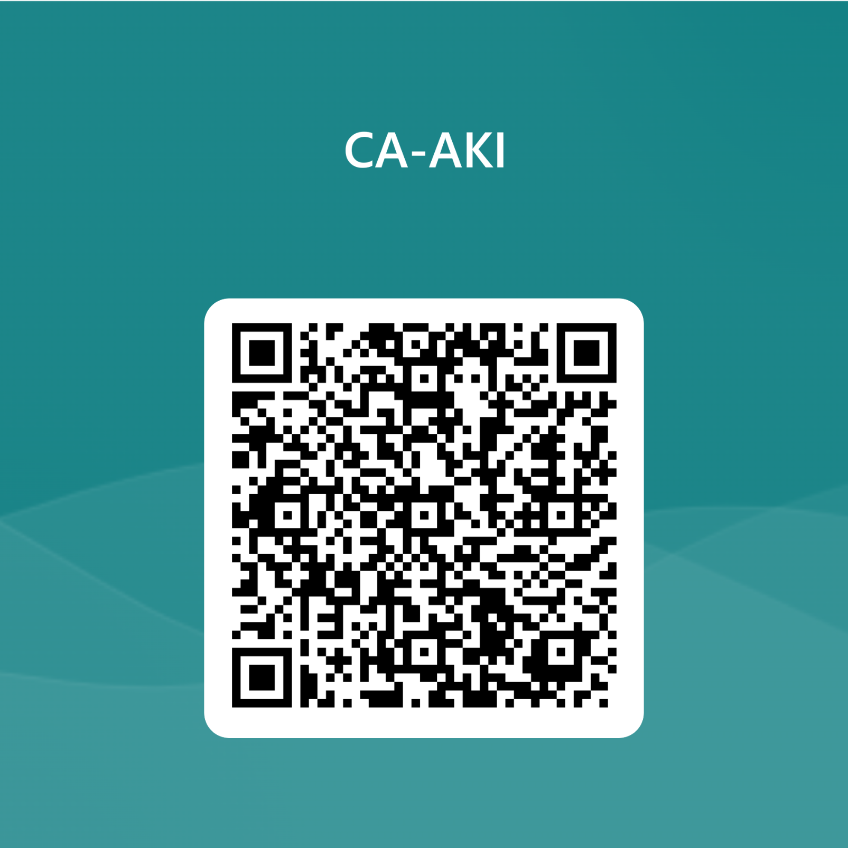
CA-AKI is it a Myth ?
Badreddin Shaibani MD, PhD
Azzawiyah kidney Hospital
Lecture for Albayda nephro-symposia 2023 March,

Slide 2
CA-AKI
Guidance on this topic requires inter-professional collaboration, given that contrast-enhanced diagnostic and therapeutic procedures are ordered by various specialties, performed by other specialists, and require management by nephrologists in the event that AKI develops

Slide 3
Review the scientific evidence for CA-AKI and provides consensus-based guidelines for its prevention and management.

Slide 4
CA-AKI
Is a general term used to describe a sudden deterioration in renal function that occurs within 48 hours after the intravascular administration of ICM.
CA-AKI may occur regardless of whether the contrast medium was, or was not, the cause of the deterioration.

Slide 5
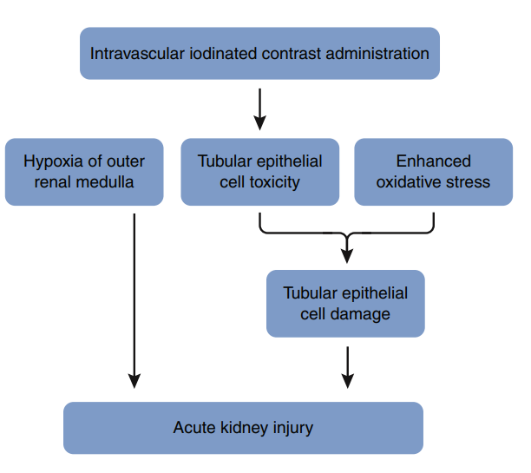
Proposed pathophysiologic mechanisms of kidney injury with iodinated contrast

Slide 6
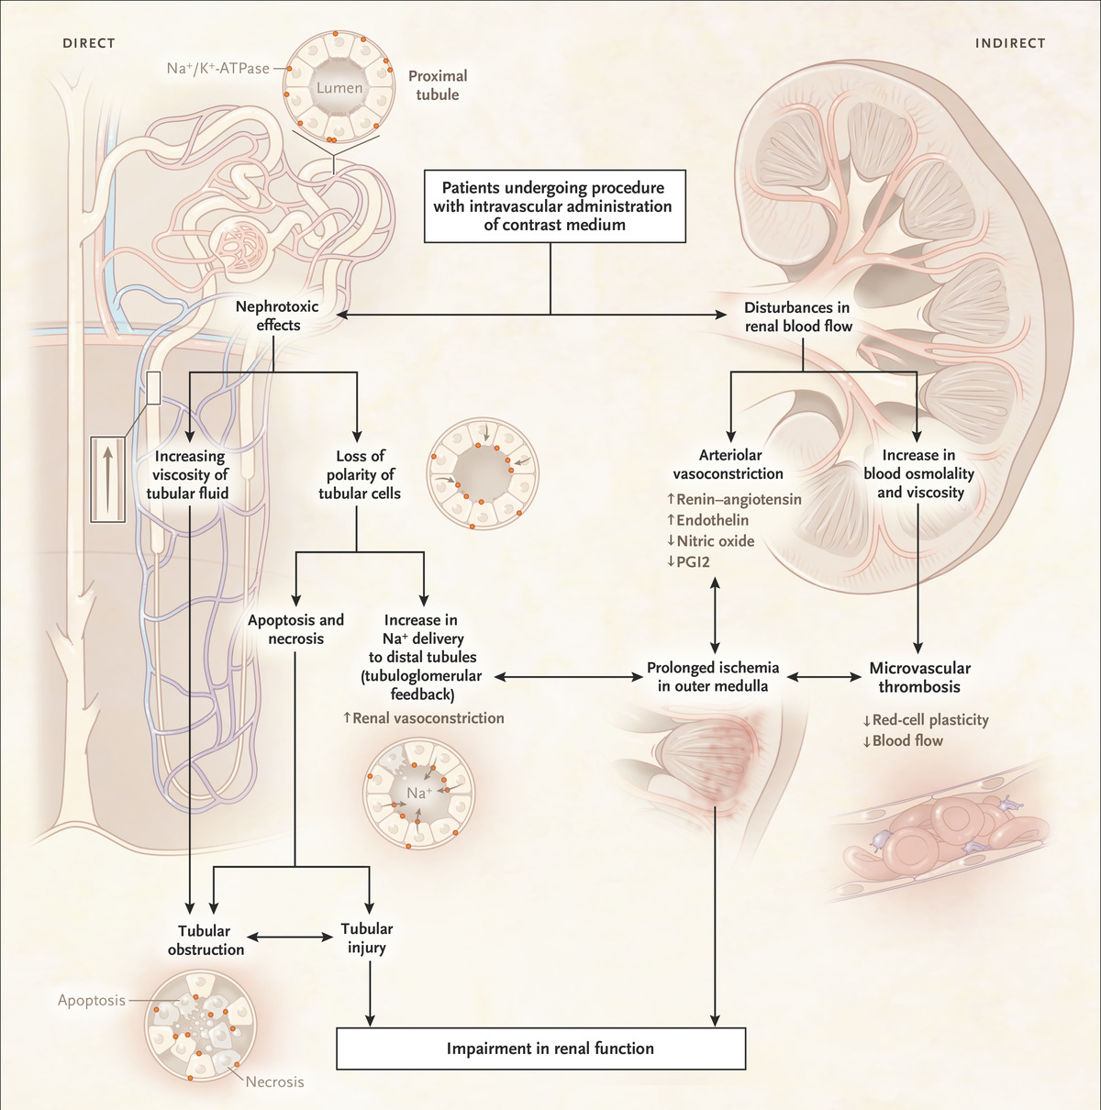
Proposed Mechanisms of CA-AKI

Slide 7
Pathophysiology and Incidence of AKI Associated with Iodinated Contrast
multifactorial. several different pathophysiologic processes occur simultaneously and in sequence
Intrarenal vasoconstriction, generation of reactive oxygen species, and direct tubular damage are the predominant factors that lead to CI-AKI.
Contrast agents increase the release of adenosine, endothelin, and free radical species which induce vasoconstriction coupled with impaired nitric oxide and prostaglandin-induced vasodilatation.
These mechanisms cause ischemia in the deeper portion of the outer medulla, an area with high oxygen requirement and remote from the vasa recta supplying the renal medulla with blood.
Contrast agents retained in kidneys have direct toxic effects on renal tubular cells causing vacuolization, altered mitochondrial function and apoptosis

Slide 8
Risk / benefit

Slide 9
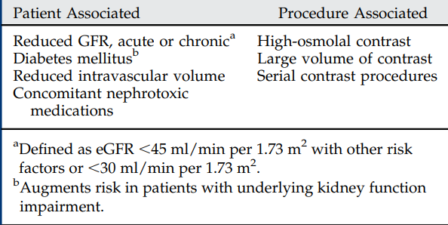
Contrast-associated AKI risk factors

Slide 10
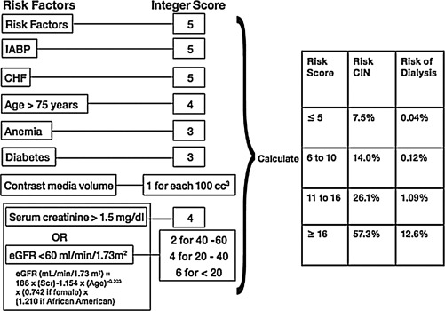
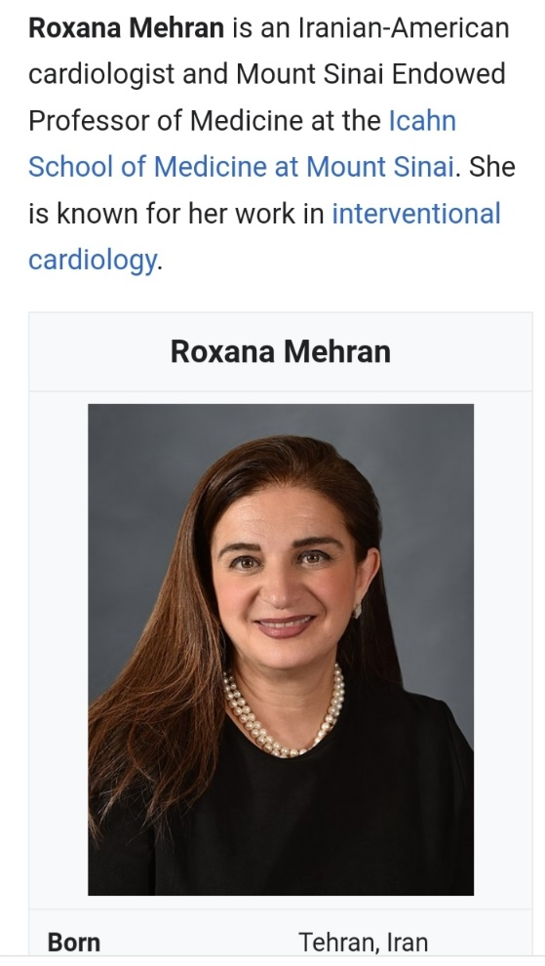
Mehran CA-AKI risk score
https://www.mdcalc.com/calc/10087/mehran-score-post-pci-contrast-nephropathy

Slide 11
Changes to Recommendations Between
2012 and 2022 Guidelines

Slide 13
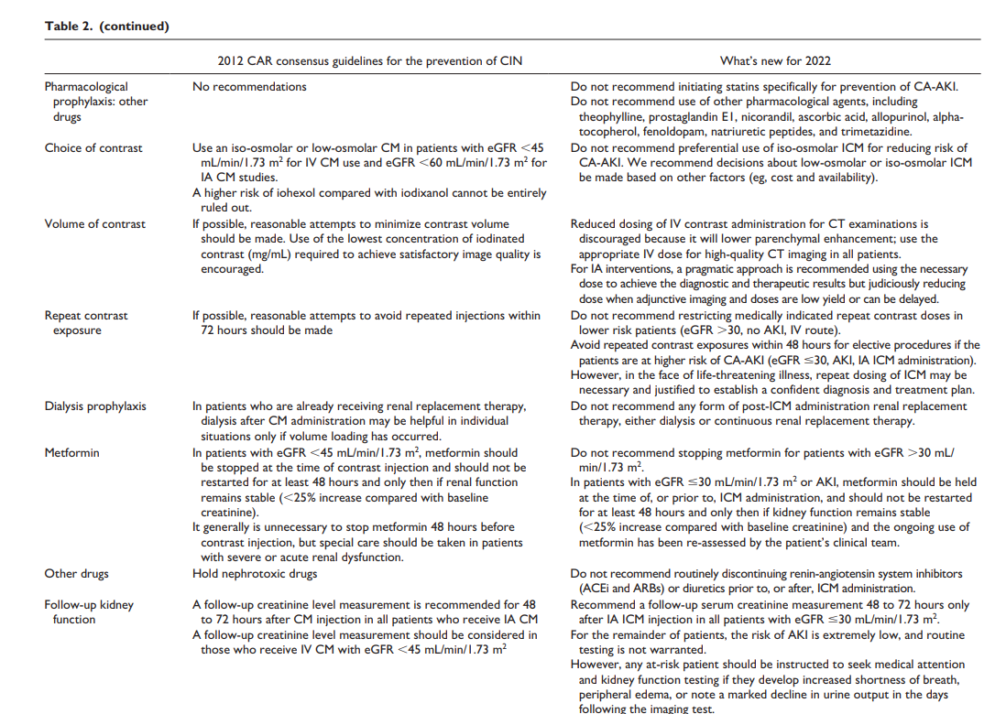

Slide 14
Prophylaxis of CA-AKI We do not recommend
oral or IV hydration for patients with eGFR >30 mL/min/1.73 m2 , receiving IV ICM or IA ICM.
For patients with eGFR ≤30 mL/min/1.73 m2 receiving IV ICM, there is a lack of evidence on benefit of volume expansion. Hence, the working group makes no recommendation in this regard; institutions may choose practices best suited to their local environments.
For patients with eGFR ≤30 mL/min/1.73 m2 receiving IA ICM, some members of the working group endorsed a strategy of hydration and volume expansion using either IV hydration (with 0.9% saline or 1.26% sodium bicarbonate) or oral salt and water. Since there is insufficient evidence in this patient group, the working group felt that the use of hydration or not and the route of hydration were best left to judgment of the practitioner.

Slide 15
Prophylaxis of CA-AKI We do not recommend
preferential use of iso-osmolar ICM for reducing risk of CA-AKI. We recommend decisions about low-osmolar or isoosmolar ICM be made based on other factors (eg, cost and availability).
any form of post-ICM administration RRT, either dialysis or continuous RRT for reduction of the risk of CA-AKI.
NAC use for the prophylaxis of CA-AKI.
initiating statins specifically for prevention of CA-AKI.
use of other pharmacological agents which have been described in the literature, including theophylline, prostaglandin E1, nicorandil, ascorbic acid, allopurinol, alpha-tocopherol, fenoldopam, natriuretic peptides, and trimetazidine

Slide 16
there is no role for routine extracorporeal removal of ICM with dialysis.
If CA-AKI occurs, we suggest that clinical evaluation and management of AKI due to CA-AKI be undertaken according to the KDIGO clinical practice guidelines for AKI

Slide 17
Medication considerations
We do not recommend stopping metformin before contrast injection, and/or retesting kidney function afterward, for patients with eGFR >30 mL/ min/1.73 m2 .
We recommend that in patients with eGFR ≤30 mL/min/1.73 m2 or AKI, metformin should be held at the time of, or prior to, ICM administration. Metformin should not be restarted for at least 48 hours and only then if kidney function remains stable (<25% increase compared with baseline creatinine) and the ongoing use of metformin has been reassessed by the patient’s clinical team.
We do not recommend routinely discontinuing RAS inhibitors (ACEi and ARBs) prior to, or after, ICM administration.
We do not recommend routinely discontinuing diuretics prior to, or after, ICM administration

Slide 18
Post-ICM administration statements
We recommend a follow-up serum creatinine measurement 48 to 72 hours after IA ICM injection in all patients with eGFR ≤30 mL/min/1.73 m2 .
For the remainder of patients, the risk of AKI is extremely low, and routine testing is not warranted. However, any at-risk patient should be instructed to seek medical attention and kidney function testing if they develop increased shortness of breath, peripheral edema, or note a marked decline in urine output in the days following the imaging test.
We recommend that clinical evaluation and management of AKI due to CA-AKI be undertaken according to the KDIGO clinical practice guidelines for AKI.

Slide 19
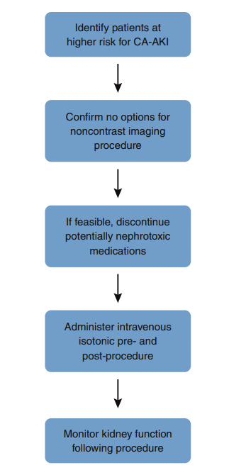
Recommended approach for prevention of CA-AKI.

Slide 20
Conclusion
Recent studies provide convincing evidence that nephrotoxicity after CA-AKI is an unusual phenomenon in hospitalized patients.
It is probably still more rare in outpatients who are generally healthier than hospitalized patients.
Post- CA-AKI nephrotoxicity occurs less frequently than after angiocardiographic procedures, and
comorbid conditions may be the driving force behind post- CA-AKI renal dysfunction.

